Slide 1


GLYCOS AI
Healthcare Diagnosis Support
A Client-Side Metabolic Intelligence Platform
PRESENTED BY
COURSE DETAILS
Eshwar Miyyapuram (2420030644)
Subject: Data Science
Akshay Kumar (2420030604)
Faculty: Dr. D Bheekya Sir

Slide 2

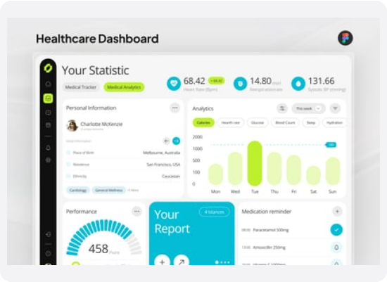
What is GLYCOS AI?
GLYCOS AI is a high-fidelity, interactive clinical tool operating entirely in the user's browser to protect sensitive patient data.
•
Privacy First: No patient metrics are sent to external servers. Calculations happen client-side.
•
Clinical Intelligence: Computes Type 2 diabetes susceptibility risk percentages instantly.
•
Immersive Experience: Uses advanced WebGL and fluid UI transitions for a premium medical interface.
•
Dynamic Reporting: Generates contextual, AI-driven explanations and automated PDF summaries.

Slide 3









Core System Architecture
Visual Engine
In-Browser ML
WebGL & Audio
Powered by Vite & React. Integrates Lenis kinetic scrolling with GSAP for high-end dynamics. Features a custom fluid cursor and Bloop Wipe/Pixel Reveal transitions.
Features a local Logistic Regression classifier via Batch Gradient Descent in JS. Supports local model training on standard cohorts or custom patient CSVs.
Procedural 3D node lattice using Three.js that visually connects clinical factors. Accompanied by a Web Audio HTML5 engine providing a deep atmospheric 45Hz hum.

Slide 4


UX & Visual Integration
Metabolic Data Parser
Context-Aware Consultation
Users can drag & drop clinical files (.pdf, .xlsx, .csv) or paste plain text. The suite dynamically imports pdf.js and standard xlsx libraries directly in the browser.
Includes an AI chat terminal that allows clinicians or patients to ask follow-up questions. The system auto-injects all computed metrics.
When completed, it assembles a high-contrast clinical record layout and compiles it into a downloadable PDF using the html2pdf.js library.
Performs automated text parsing via Azure OpenAI (gpt-4o-mini). If offline, it seamlessly falls back to custom local regular expressions to extract metabolic terms.

Slide 5

In-Browser ML Calibrator
The platform isn't just a static predictor; it allows users to locally train the prediction coefficients.
It fits a Logistic Regression classifier on either the standard PIMA Indians Cohort or a custom dataset. By executing Batch Gradient Descent entirely in JavaScript (120 epochs, learning rate = 0.25), it updates custom weights in real-time.
The interface dynamically displays binary cross-entropy loss and accuracy in a retro command line console.

Slide 6


Interactive 3D WebGL Graphics
As the user slides through manual questionnaire metrics, the Three.js WebGL camera automatically pans to focus on the active node in the metabolic lattice. The active node scales up, glows, and reflects user cursor interactions against a swarm of dynamic dust particles.

Slide 7



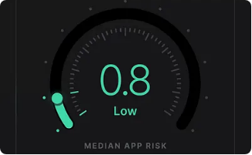
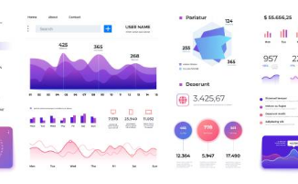
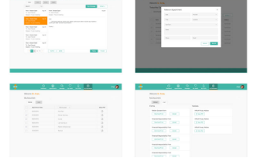
Clinical Reporting Dashboard
Odometer Risk Gauge
Probability Bell Curve
PDF Report Generator
Instantly displays the patient's calculated susceptibility percentage using an interactive, animated odometer interface.
An interactive SVG normal distribution showing the patient's relative standing compared to a standard population distribution.
Compiles biomarker contributions, AI chat context, and metrics into a downloadable PDF report for immediate clinical review.

Slide 8





The Prediction Engine Math
1. Feature Standardization
2. Logistic Regression
Input variables are scaled into standard scores (Z-scores) before processing:
The probability of susceptibility is computed via log-odds mapping:

Slide 9
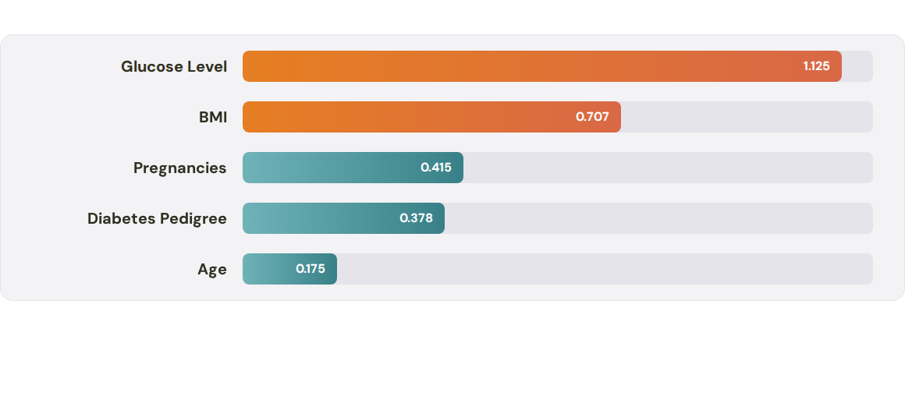
Primary Risk Drivers (Coefficients)
The chart visualizes the top 5 positive baseline model coefficients (Beta) influencing the final risk index. Variables with larger coefficients, such as Glucose and BMI, exhibit the strongest statistical impact on Type 2 diabetes susceptibility.

